Slide 1
Introduction Data Engineering
Enterprise Data management
Aspects of Data management
What is Data Enigneering
How Data Engineering is Evolving
What Skills Required to Data Engineer

Slide 2
Enterprise Data Managemnt
DataGovernance
DataQuality
MetaData Management
Data Integration
Security & Privacy
Data Observability

Slide 3
Data Governance
Govern Data
Classify Data & implements Data Access roles
Delegate Ownership of Data
Responsible for Data Protection Standards like GDPR

Slide 4
Enterprise Data Quality
Missing Values, formats , precisions check
Data Completeness

Slide 5
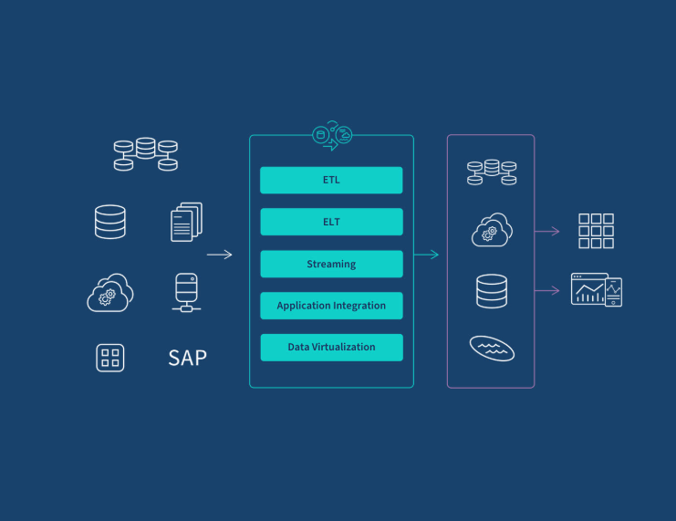
Data Integration

Slide 6
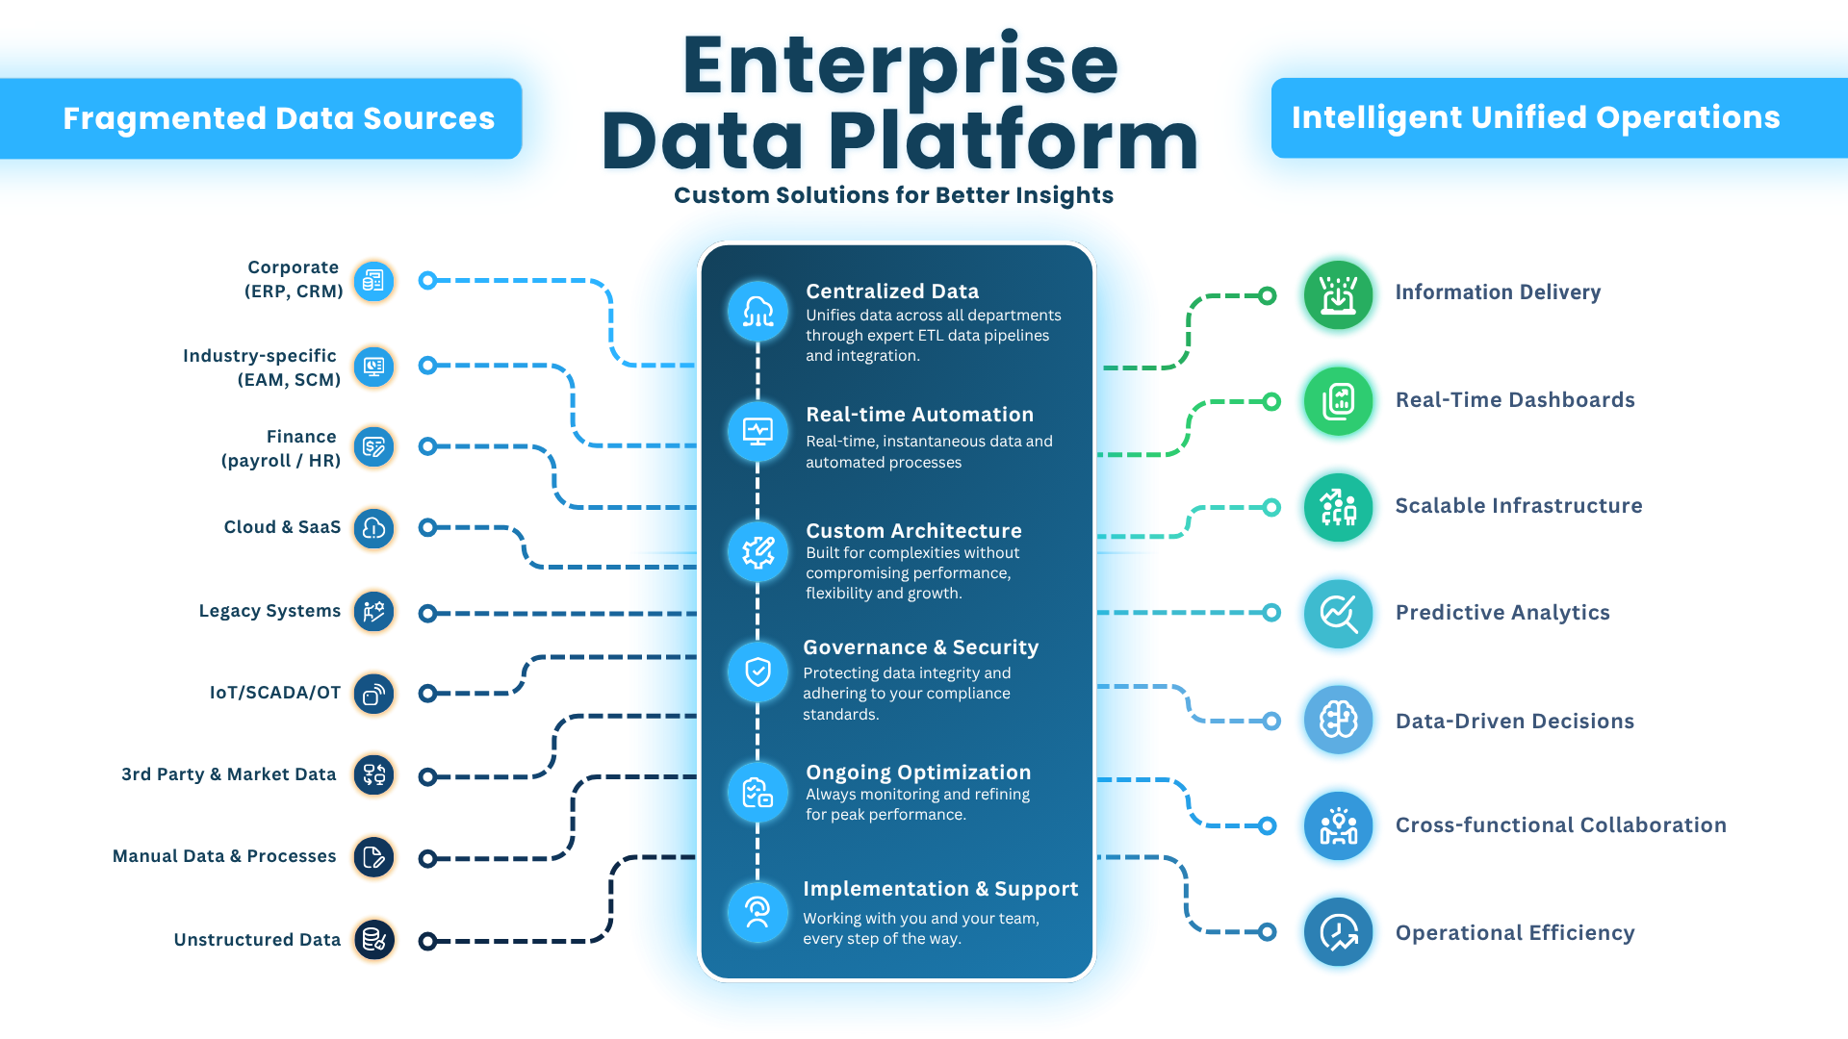
Enterprise Data Platform

Slide 7
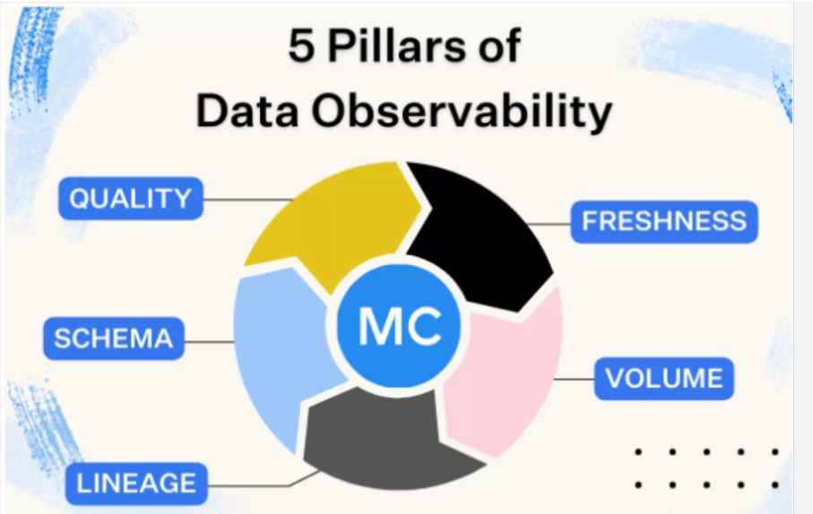
Data Observability

